Slide 1

Company Rating Website
Capstone Project
Presentation
卒業論文
プレゼンテーション
Summer 2016
Notes:
To replace this picture, just select and delete it. Then use the Insert Picture icon to replace it with one of your own!

Slide 2
私達について
About Us
ChienBD
HungNV
QuangNN
LamNS
DangT
HungTQ

Slide 3
アウトライン
Outlines
1
Introduction - 導入
2
Project Management - プロジェクト管理
3
Software Requirement Specification - ソフトウェア要求仕様
4
5
6
7
8
Software Design Description - ソフトウェア設計説明書
Quality Control - 品質管理
Project Result - プロジェクト結果
Demo - デモ
Q & A - 質問と回答

Slide 4
アウトライン
Outlines
1
Introduction - 導入
2
Project Management - プロジェクト管理
3
Software Requirement Specification - ソフトウェア要求仕様
4
5
6
7
8
Software Design Description - ソフトウェア設計説明書
Quality Control - 品質管理
Project Result - プロジェクト結果
Demo - デモ
Q & A - 質問と回答

Slide 5
1 – Introduction - 導入
1.1 Current Situation - 現在状況
Nowadays, people have multiple ways to hand in their CVs, be it directly or virtually.
But
People doesn’t know whether they would fit with the company or not.
Lack of information from other workers, formerly or currently.
So
Need an environment for trading information.

Slide 6
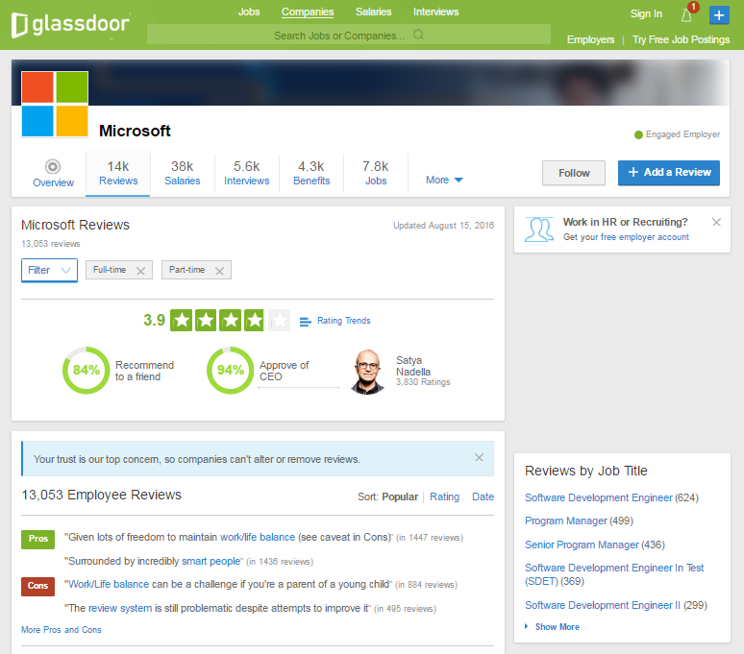
1 – Introduction - 導入
1.1 Current Situation - 現在状況
Glassdoor.com
Advantages:
Famous.
Controllable level of details on review.
Connection to employers.
Disadvantages:
Does not support Vietnamese.
UI is unintuitive.
Unclear how gathered information are used.

Slide 7
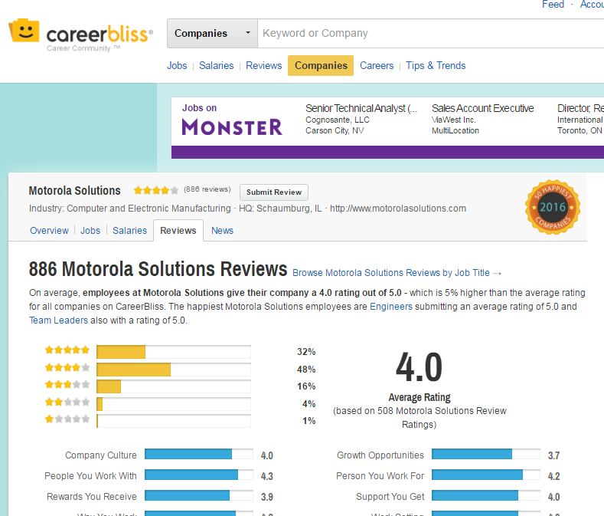
1 – Introduction - 導入
1.1 Current Situation - 現在状況
CareerBliss.com
Advantages:
Intuitive design.
Information is scientifically generalized.
Does not require an account.
Disadvantages:
Only accept US based company.
Lacking in information.
Does not support Vietnamese.

Slide 8
1 – Introduction - 導入
1.2 The Idea - アイデア
Create a website that
Helps user to have an insider’s view from employees/ex-employees’ review on any available company.
Share anything they like, be it about the profession’s upbringing, the opinions of those who worked there, or just simply how well the employee would be treated.
Discuss with other people.

Slide 9
1 – Introduction - 導入
1.3 Proposal - 提案
Build a website:
Use NodeJs, AngularJSl. MongoDB... technology.
Support Vietnamese users.
Improve team member in:
Development, management, teamwork skill.
Technical experience.

Slide 10
アウトライン
Outlines
1
Introduction - 導入
2
Project Management - プロジェクト管理
3
Software Requirement Specification - ソフトウェア要求仕様
4
5
6
7
8
Software Design Description - ソフトウェア設計説明書
Quality Control - 品質管理
Project Result - プロジェクト結果
Demo - デモ
Q & A - 質問と回答

Slide 11
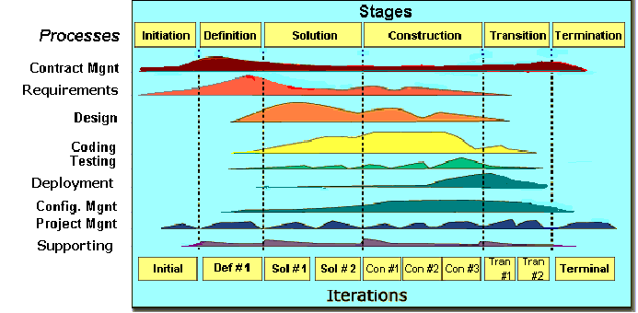
2 - Project Management - プロジェクト管理
2.1 Software Process Model - ソフトウェアプロセスモデル
FPT Software
process model

Slide 12
2 - Project Management - プロジェクト管理
2.1 Software Process Model - ソフトウェアプロセスモデル
Initiation
Identify business functions of the system.
Solution
Complete SRS, Architecture Design and Database Design.
Construction
Report #3, Report #4.
Termination
Complete software packages and Report #5, #6.
Determine scope, condition, limitation, project risk.
List main functions.
Complete Report #1.
Complete Report #2.
Complete Coding and Testing.
Preparing presentation.
Complete Project.

Slide 13
2 - Project Management - プロジェクト管理
2.2 Project Organization - プロジェクト組織
Bùi Đình Chiến
Instructor
Nguyễn Sơn Lâm
Test Leader/QA
Trần Quốc Hưng
Designer
Trần Đăng
Technical Leader
Nguyễn Nhật Quang
Developer
Trần Quốc Hưng
Developer
Nguyễn Việt Hùng
Developer
Nguyễn Nhật Quang
Tester
Trần Quốc Hưng
Project manager
Nguyễn Sơn Lâm
Designer

Slide 14
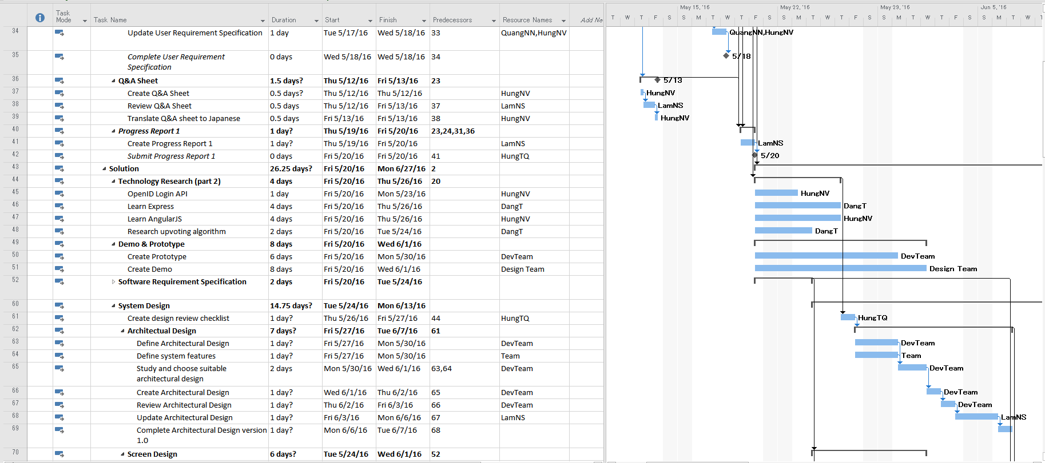
2 - Project Management - プロジェクト管理
2.3 Project Schedule - プロジェクト計画

Slide 15
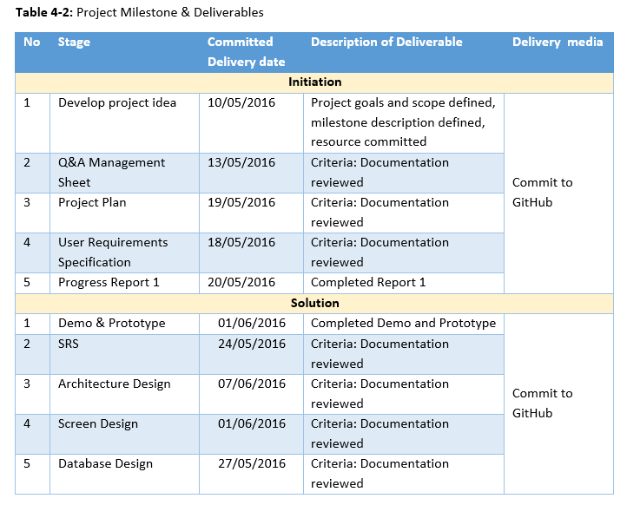
2 - Project Management - プロジェクト管理
2.4 Objectives & Deliverables - 目標と成果物

Slide 16












2 - Project Management - プロジェクト管理
2.5 Tools & Infrastructure - ツールと インフラストラクチャ
Tools for project management:
Tools for developing:
Visual Pradigm
Word 2015
Sublime Text
Chrome
Github desktop
Excel 2015
Putty
Redmine
MS Project 2013
PowerPoint 2015
Acunetix WVS 10.5
Vim

Slide 17
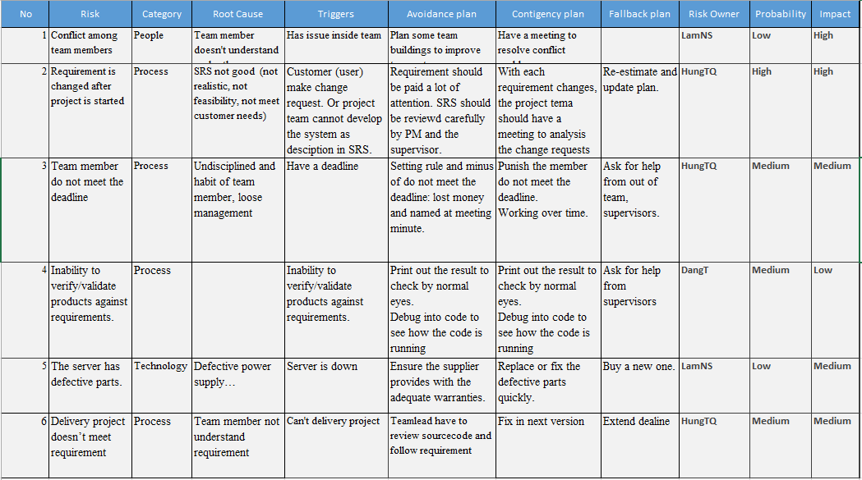
2 - Project Management - プロジェクト管理
2.6 Risks Management - リスク管理

Slide 18
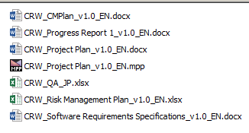
2 - Project Management - プロジェクト管理
2.7 Configuration Management - コンフィグレーション管理
Rule:
ProjectCode_Document’s name_v<x.x>_language
ProjectCode: CRW
Document’s name: Project Plan, Progress Report…
v<x.x>: Document’s version. Ex: v1.0, v1.1,…
Language:
EN: English
JP: Japanese
Naming conventions

Slide 19





2 - Project Management - プロジェクト管理
2.8 Communication Management - コミュニケーション管理

Slide 20
アウトライン
Outlines
1
Introduction - 導入
2
Project Management - プロジェクト管理
3
Software Requirement Specification - ソフトウェア要求仕様
4
5
6
7
8
Software Design Description - ソフトウェア設計説明書
Quality Control - 品質管理
Project Result - プロジェクト結果
Demo - デモ
Q & A - 質問と回答

Slide 21



3 – Software Requirement Specification
ソフトウェア要求仕様
3.1 Business Actors -ビジネスアクター
Administrator
User
Moderator

Slide 22
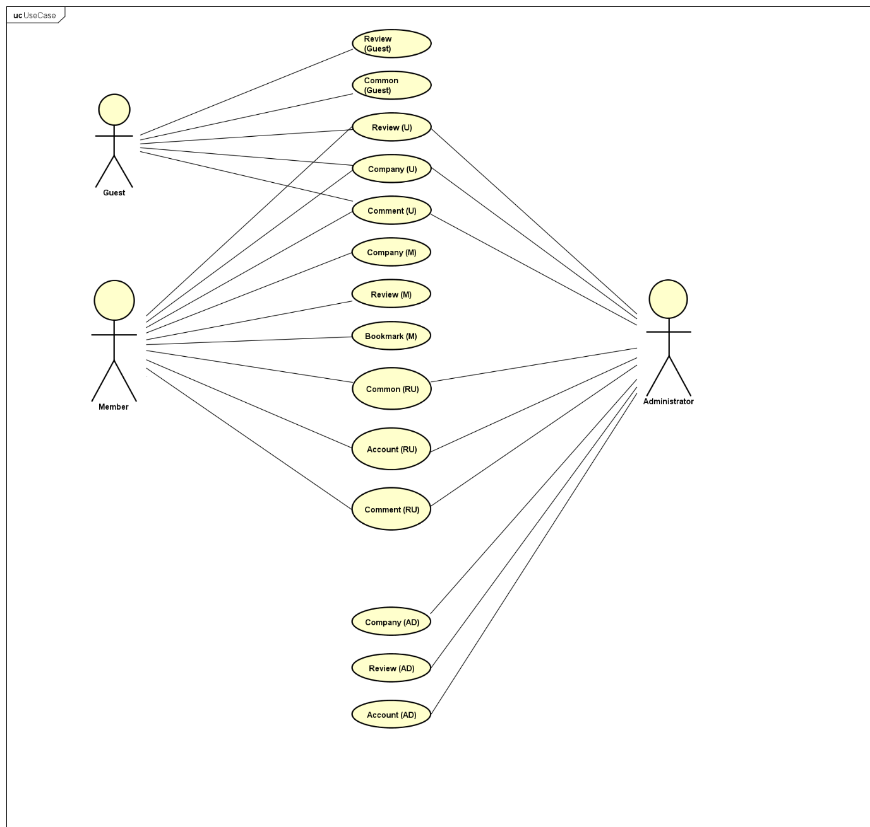
3 – Software Requirement Specification
ソフトウェア要求仕様
3.2 Functional Requirements - 機能要求

Slide 23
3 – Software Requirement Specification
ソフトウェア要求仕様
3.3 Non-functional Requirements - 非機能要求
Mean time between each failure is expected to be around 480 hours of actual usage.
Maximum bugs per function are 2 bugs/function within 2 months of actual usage.
Average number of bugs in the software during system testing is expected to be around 1 bug/KLOC.
Database must be backed up on a daily basis and can be recovered whenever necessary.

Slide 24
アウトライン
Outlines
1
Introduction - 導入
2
Project Management - プロジェクト管理
3
Software Requirement Specification - ソフトウェア要求仕様
4
5
6
7
8
Software Design Description - ソフトウェア設計説明書
Quality Control - 品質管理
Project Result - プロジェクト結果
Demo - デモ
Q & A - 質問と回答

Slide 25
4 – Software Design Description
ソフトウェア設計説明書
4.1 Architectural Representation –アーキテクチャ表現
Technology
MongoDB
ExpressJS
AngularJS
NodeJS

Slide 26
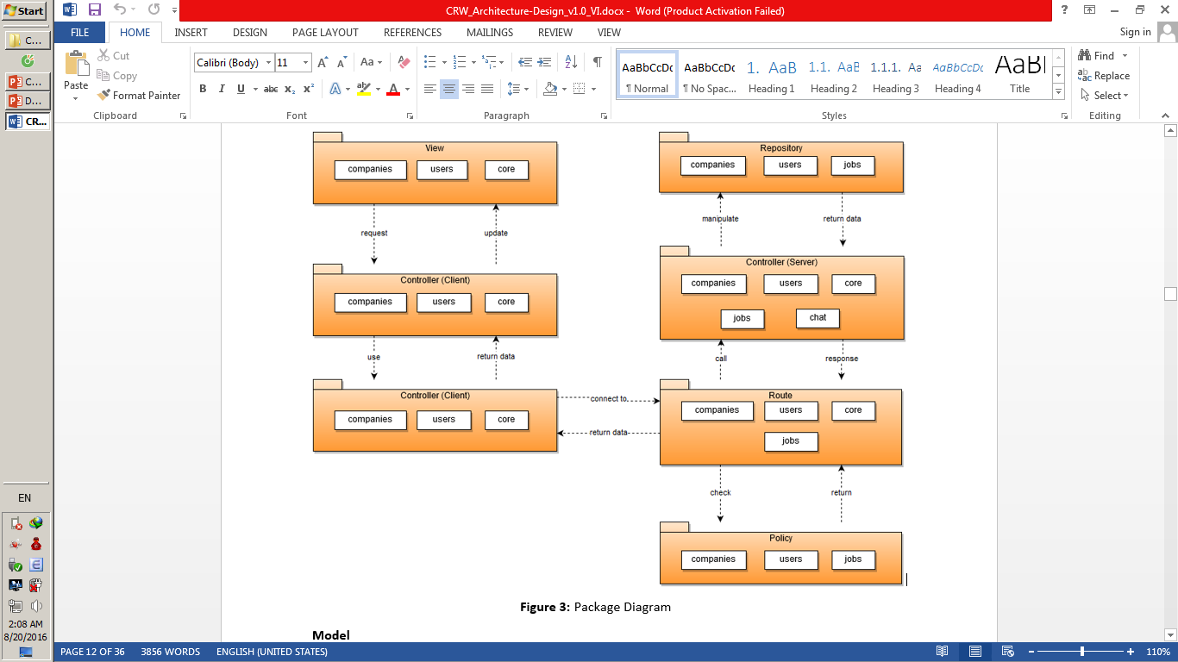
4 – Software Design Description
ソフトウェア設計説明書
4.2 Package Diagram - パッケージ図

Slide 27
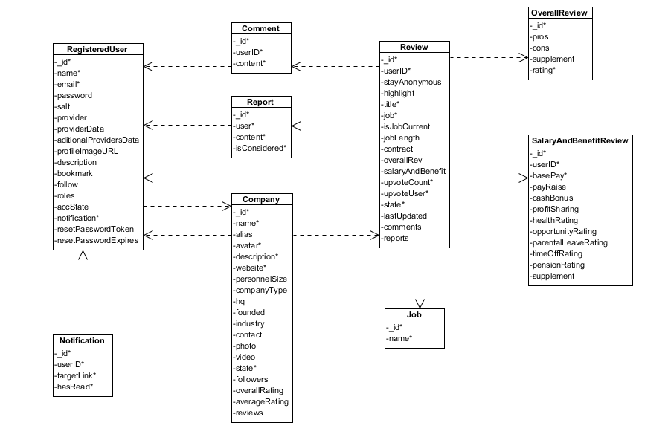
4 – Software Design Description
ソフトウェア設計説明書
4.3 Database Design -データベース設計

Slide 28
4 – Software Design Description
ソフトウェア設計説明書
4.4.1 Screen Flow - 画面の流れ

Slide 29
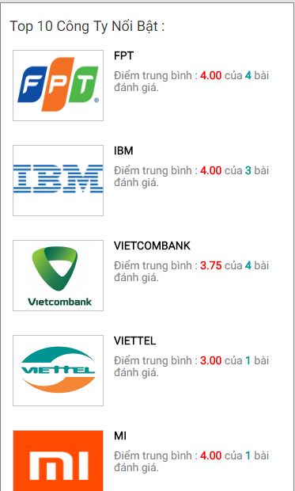
4 – Software Design Description
ソフトウェア設計説明書
4.4.2 Screen Design - 画面設計
No | Field name | Field name in Vietnamese | Type | Require | Description
1 | Top 10 | Tốp 10 | Label |  | Label for Top 10 Companies section
2 | Company Avatar | Ảnh đại diện công ty | Image |  | Company’s logo
3 | Company Name | Tên công ty | Label |  | Company’s name
4 | Average Rating | Điểm đánh giá trung bình | Label |  | Label for Average Rating and amount of reviews
5 | Average Star Rating | Điểm đánh giá trung bình | Star Rating Bar |  | Show average ratings of this company as stars
6 | Company Thumbnail | Công ty | Hyperlink | Click | Go to the Detailed Company screen of this company

Slide 30
4 – Software Design Description
ソフトウェア設計説明書
4.5.1 Class Design -クラス設計

Slide 31
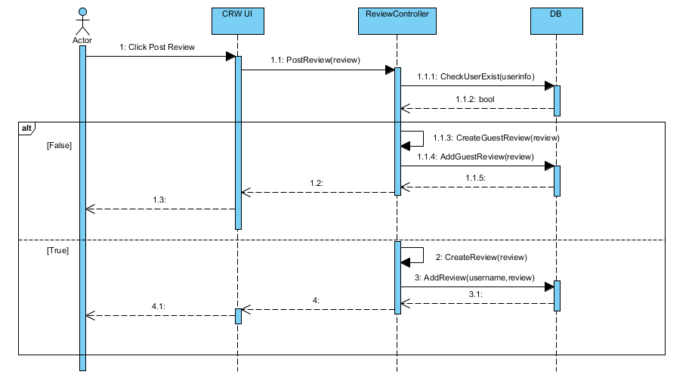
4 – Software Design Description
ソフトウェア設計説明書
4.5.2 Sequence Diagram -シーケンス図

Slide 32
アウトライン
Outlines
1
Introduction - 導入
2
Project Management - プロジェクト管理
3
Software Requirement Specification - ソフトウェア要求仕様
4
5
6
7
8
Software Design Description - ソフトウェア設計説明書
Quality Control - 品質管理
Project Result - プロジェクト結果
Demo - デモ
Q & A - 質問と回答

Slide 33
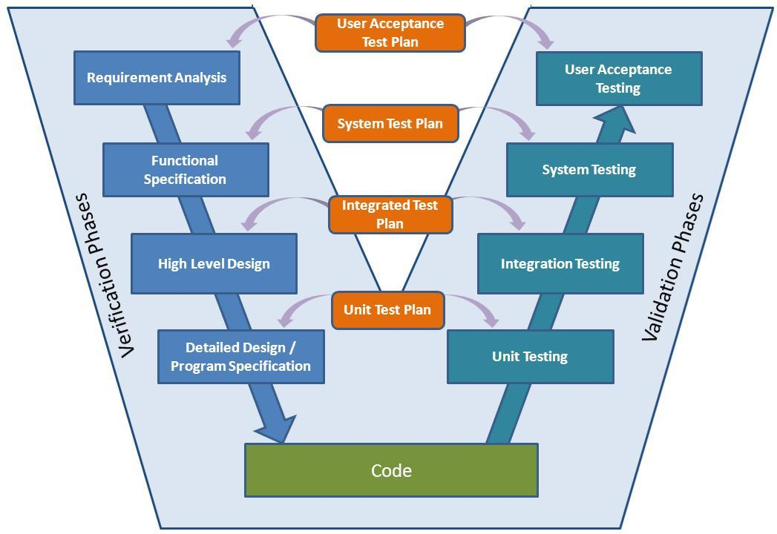
5 – Quality Control - 品質管理
V-model process

Slide 34
5 – Quality Control - 品質管理
5.1 Review - レビュー
Project Plan
SRS
Design
Coding
Test Document

Slide 35
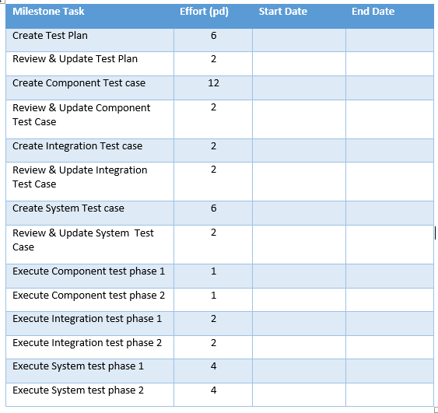
5 – Quality Control - 品質管理
5.2.1 Test Process -テストのプロセス
Test Plan
Test Case
Review Test Case
Test Report
Execute Test
Log Bug
Re-test
Base on Project Plan, Project Schedule, SRS to create test plan:
Acceptance test criteria:
Statement coverage: 100%
Branch coverage: 100%
Path coverage: 100%
Test Approach:
Unit Test: Developer
Integration Test: Tester
System Test: Tester
Acceptance Test: Customer
Test Environment:
Chrome 40 or above
Firefox 30 or above

Slide 36
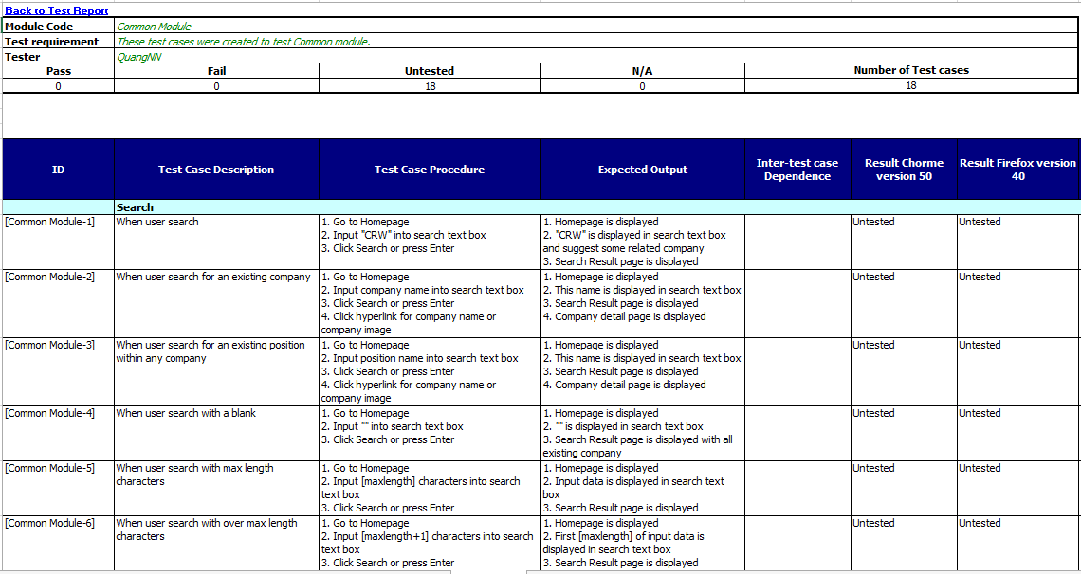
5 – Quality Control - 品質管理
5.2.1 Test Process -テストのプロセス
Test Plan
Test Case
Review Test Case
Test Report
Execute Test
Log Bug
Re-test

Slide 37
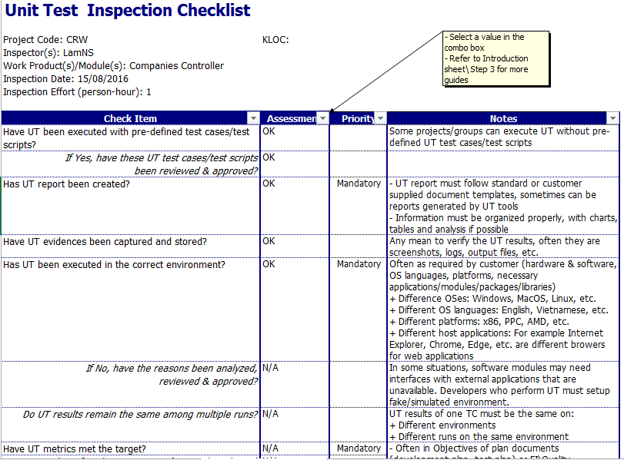
5 – Quality Control - 品質管理
5.2.1 Test Process -テストのプロセス
Test Plan
Test Case
Review Test Case
Test Report
Execute Test
Log Bug
Re-test

Slide 38
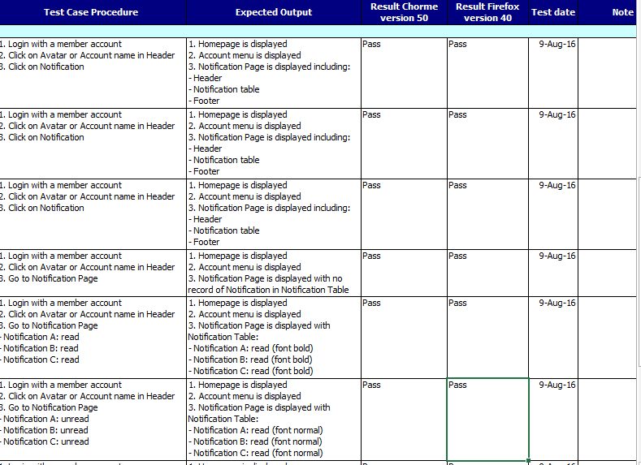
5 – Quality Control - 品質管理
5.2.1 Test Process -テストのプロセス
Test Plan
Test Case
Review Test Case
Test Report
Execute Test
Log Bug
Re-test

Slide 39
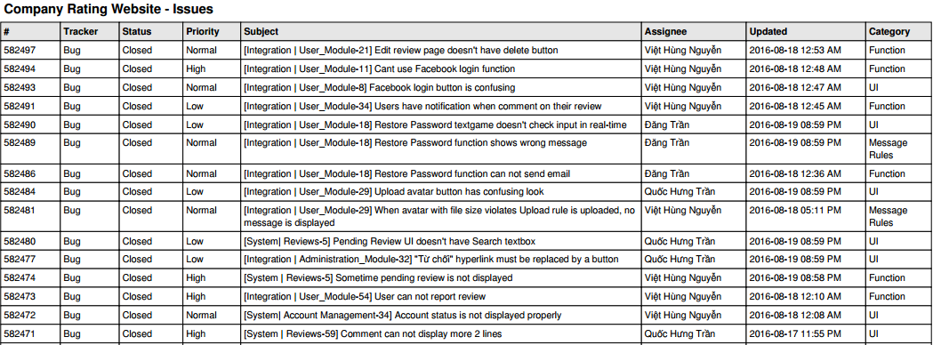
5 – Quality Control - 品質管理
5.2.1 Test Process -テストのプロセス
Test Plan
Test Case
Review Test Case
Test Report
Execute Test
Log Bug
Re-test
Exported from hostedredmine.com

Slide 40
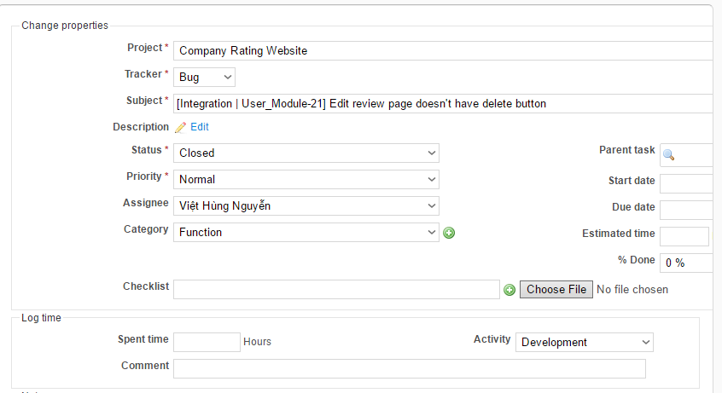
5 – Quality Control - 品質管理
5.2.1 Test Process -テストのプロセス
Test Plan
Test Case
Review Test Case
Test Report
Execute Test
Log Bug
Re-test
Fix bug
Re-test to confirm
Change defect’s status to Closed.

Slide 41
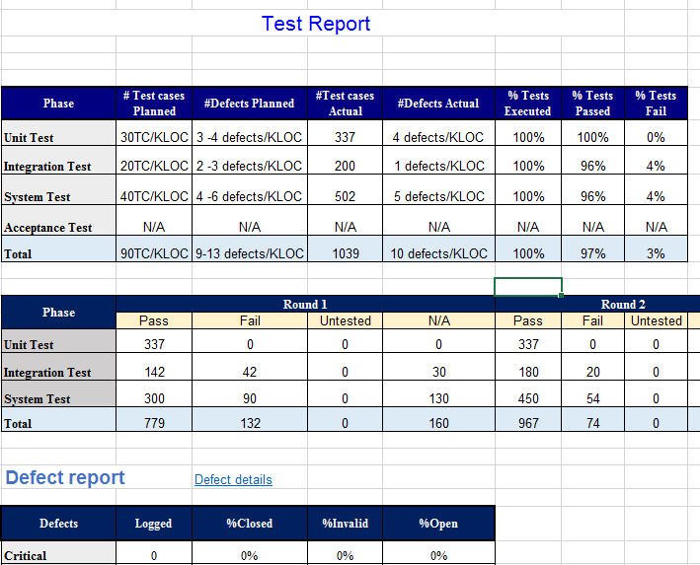
5 – Quality Control - 品質管理
5.2.1 Test Process -テストのプロセス
Test Plan
Test Case
Review Test Case
Test Report
Execute Test
Log Bug
Re-test
Tester write test report for each test phase
Test leader create Test report after finish testing phase

Slide 42
5 – Quality Control - 品質管理
5.2.2 Test Report -テストのレポート
Defects | Logged | %Closed | %Invalid | %Open
Critial | 0 | 0% | 0% | 0%
High | 12 | 100% | 0% | 0%
Medium | 29 | 90% | 0% | 10%
Low | 28 | 100% | 0% | 0%
Total | 50 | 96% | 0% | 4%

Slide 43
5 – Quality Control - 品質管理
5.2.2 Test Report -テストのレポート
Phase | Round 1 |  | Round 2 |  | Round 3
 | Pass | Fail | Pass | Fail | Pass | Fail
Unit Test | 322 | 0 | 337 | 0 | 337 | 0
Intergration Test | 142 | 42 | 180 | 20 | 192 | 8
System Test | 300 | 90 | 450 | 54 | 484 | 20
Total | 779 | 132 | 967 | 75 | 1013 | 28

Slide 44
アウトライン
Outlines
1
Introduction - 導入
2
Project Management - プロジェクト管理
3
Software Requirement Specification - ソフトウェア要求仕様
4
5
6
7
8
Software Design Description - ソフトウェア設計説明書
Quality Control - 品質管理
Project Result - プロジェクト結果
Demo - デモ
Q & A - 質問と回答

Slide 45
6 – Project Result - プロジェクト結果
6.1 Project summary - プロジェクト要約
Main Objective | Create a website that helps user to have an insider’s view from employees/ex-employees’ review on any available company.
Source repository | https://github.com/ShiroNek0/CRW
 | Plan | Actual
Start date | 09/05/2016 | 09/05/2016
End date | 24/08/2016 | 24/08/2016
Duration | 80 | 80
Efforts (person day) | 400 | 400
Test cases | ~1000 | 1043
Defects | 135 | 50
LOC (NodeJs) | ~5000 | 5149
LOC (HTML) | ~5000 | 4975
LOC (Angular) | ~2000 | 3094
LOC (Total) | ~12000 | 13218

Slide 46
6 – Project Result - プロジェクト結果
6.2 Limitation & Expectation - 制限と期待
Limitation:
Some screens can’t scale for Mobile or monitor with resolution bigger than 1366x768.
No English interface.
Little interaction between users.
Expectation in future:
Support multi-language.
Responsive design for mobile.
More interaction between users (PM, Chatbox, Award, Achievement…).

Slide 47
6 – Project Result - プロジェクト結果
6.3 Lessons Learnt -学んだ教訓
Lesson learnt:
Working in group and working individually.
Putting knowledge into practice.
Manage time and making plan.
Be open for opinions from other members.
Limit and resolve conflicts between members.

Slide 48
アウトライン
Outlines
1
Introduction - 導入
2
Project Management - プロジェクト管理
3
Software Requirement Specification - ソフトウェア要求仕様
4
5
6
7
8
Software Design Description - ソフトウェア設計説明書
Quality Control - 品質管理
Project Result - プロジェクト結果
Demo - デモ
Q & A - 質問と回答

Slide 49

Q & A
質問と回答

